Slide 1
Understanding Artificial Intelligence
Powered by AI
AI Basics | 2025-03-20

Slide 2
AI's Core Components Explained
AI relies on data, algorithms, and models. Algorithms process data to build predictive models, enabling AI to learn and make decisions.
These models are refined through training and testing, improving accuracy and performance over time.
AI Basics | 2025-03-20

Slide 3
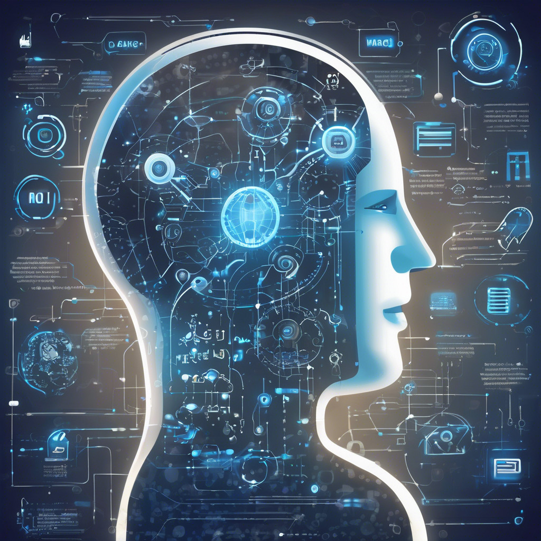
Machine Learning: The Engine of AI
Machine learning empowers AI by enabling computers to learn from data without explicit programming, improving accuracy over time. Algorithms identify patterns, make predictions, and adapt autonomously.
This automated learning drives advancements in various fields, from image recognition to natural language processing, fueling the rapid growth of artificial intelligence applications.
AI Basics | 2025-03-20

Slide 4
AI Basics Future
AI's future involves advanced capabilities like problem-solving and decision-making across various sectors. Ethical considerations and responsible development are crucial for beneficial societal impact.
Expect further automation, personalized experiences, and scientific breakthroughs. However, job displacement and potential biases necessitate careful management.
AI Basics | 2025-03-20

Slide 5
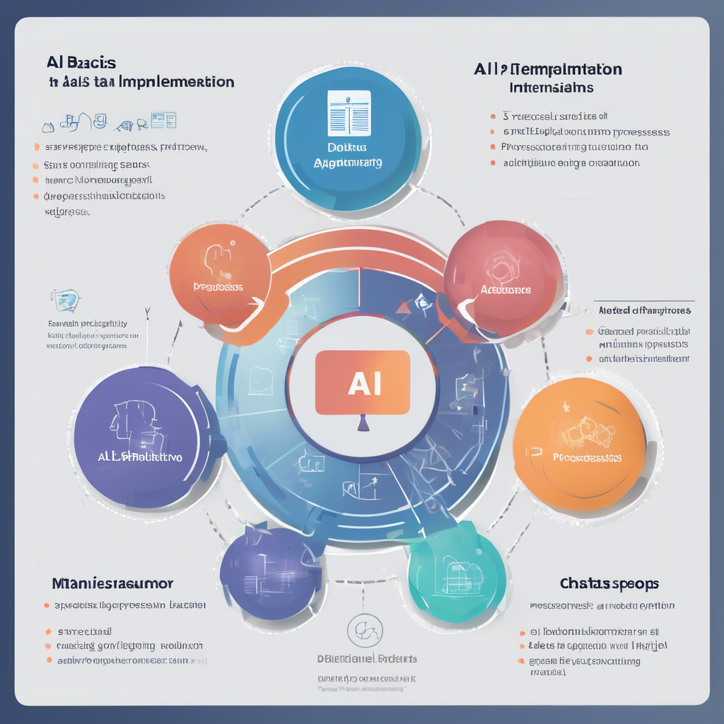
AI Basics Implementation
AI implementation starts with defining clear goals and selecting appropriate algorithms. Data preprocessing, model training, and evaluation are crucial steps.
Successful deployment requires robust infrastructure, monitoring, and continuous improvement to maintain accuracy and adapt to changing needs.
AI Basics | 2025-03-20

